Slide 1

Polygenic scores: Performance and the Importance of Ancestry
John R Shorter
Assistant Professor
Roskilde University

Slide 2
Outline
9:00 AM – 11:00 AM
40 min talk on theory of PGS/PRS. Plus, what to expect with 2 hands-on exercises
11:00 – 11:30
BREAK 1
11:30 PM – 12:30 AM
How PGS perform across ancestries. A hands-on exercise with the PGS catalog.
12:30 PM – 13:30 PM
LUNCH
13:30 PM – 14:30 PM
How do we create PRS? A hands-on lesson with LDPred2

Slide 3
Aims of this lecture
Introduction to polygenic risk scores (PGS/PRS)
Overview of polygenic models of genetic risk
Ancestry bias in genetic prediction
Learn more about disease prediction using the PRS Catalog
Learn how to create PRS using LDPred2

Slide 4
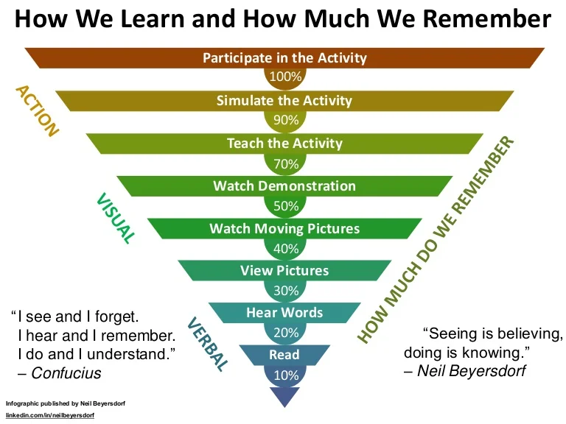

Slide 5
What is a ‘polygenic score’?
By aggregating the effects of many genetic variants into a single number, polygenic scores (PGSs) have emerged as a method to predict an individual’s genetic predisposition to a phenotype
Polygenic risk scores are calculated by summing risk alleles, which are weighted by effect sizes derived from Genome wide association study (GWAS) results
There is widespread variability in PGS research, even regarding nomenclature: the scores can be referred to as genetic or genomic scores, and as polygenic risk scores (PRSs) or genomic risk scores (GRS) if they predict a discrete phenotype (such as a disease)

Slide 6
What’s the use of PGS/PRS?
There is hope that PRS can improve health outcomes by accelerating diagnosis and matching patients to tailored treatments
Access to PRS could be helpful in targeting higher-risk people, for example to offer more screening opportunities such as mammograms, for those at a high genetic risk of breast cancer. (Discussed by Elisabeth Widen yesterday)
Guide treatment response. Certain medications may work better or worse depending on polygenic factors.

Slide 7
Genetic models of disease
Mendelian disease:
Individuals that possess the mutation get the disease.
Dominant e.g Huntington’s or recessive e.g. Cystic fibrosis
Mendelian disease with variable penetrance.
Not everyone with the mutation gets the disease.
E.g. C9orf72 in Motor Neuron Disease
Compound heterozygote disease.
Like recessive Mendelian but individuals carry two different rare mutations in the same gene.
Oligogenic diseases –caused by presence of several genetic risk variants
Polygenic diseases – caused by multiple genetic risk variants
Multifactorial diseases- caused by multiple genetic risk variants and other risk factors

Slide 8
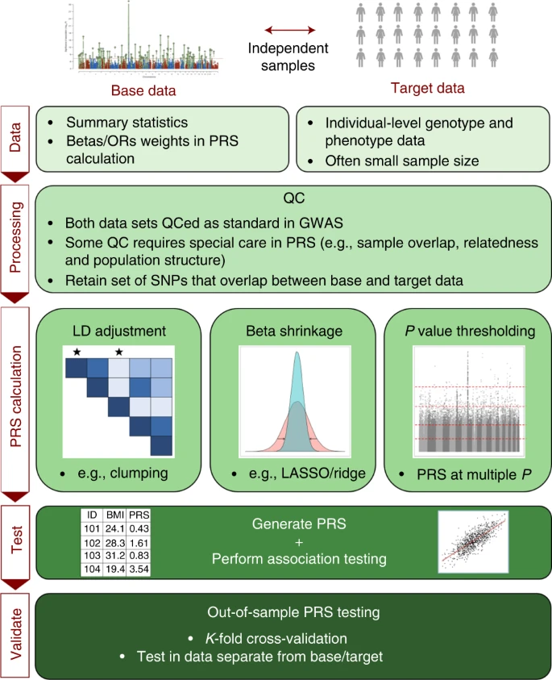
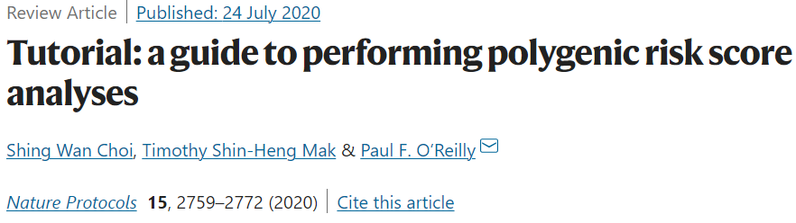
The PRS process, with many details
Issues relating to utilizing PRSs for association analyses to test hypotheses, including interpretation of results and avoidance of overfitting to the target data, are an active area of research

Slide 9
Many different PRS tools! And more will come
PLINK (Purcell et al., 2007) is a widely used open-source tool for genome-wide association studies (GWAS) and PRS analysis. It provides a comprehensive set of commands for data quality control, association analysis, and PRS calculation.
PRSice (Euesden et al., 2013) is an R package that offers a user-friendly interface for PRS analysis. It allows for flexible PRS construction and provides options for various statistical methods and p-value thresholds.
LDpred (Vilhjálmsson et al., 2015) is a tool specifically designed for PRS calculation using summary statistics from large-scale GWAS data. It incorporates linkage disequilibrium (LD) information to improve the accuracy of risk score estimation.
SBayesR (Wen et al., 2016) is a Bayesian method for PRS analysis that uses summary statistics from GWAS to estimate the effect sizes of genetic variants. It has been shown to perform well, particularly when the heritability of the trait is low.
PRS-CS (Ge et al., 2019) is a tool that incorporates LD information and functional annotations to estimate the effect sizes of genetic variants and calculate PRS. It aims to improve the accuracy of PRS by leveraging additional information beyond summary statistics.
LDpred2: (Prive et al., 2020) better, faster, stronger version
LDpred3: The LD strikes back; SBayesR4: A New Hope; PRSice5: The Return of the User-friendly Interface

Slide 10
I don’t care, just tell me what one is best!

Slide 11
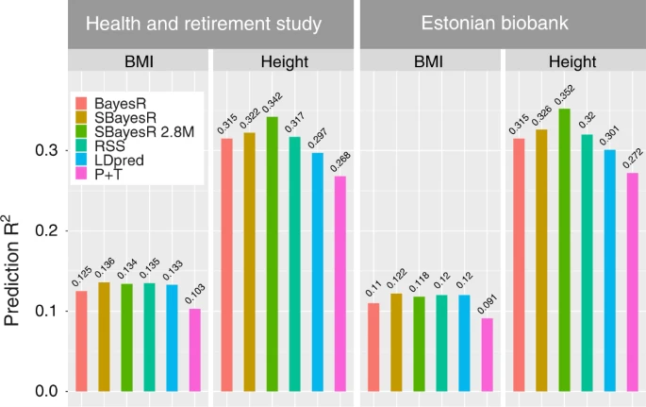
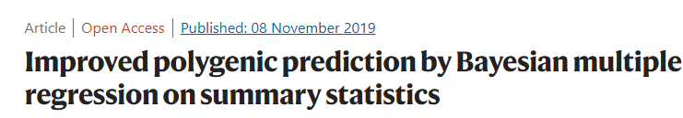
How do they perform? What one is the best?

Slide 12
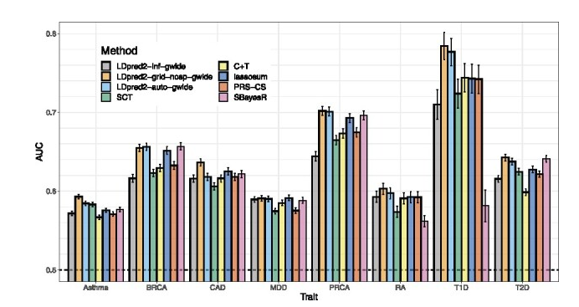
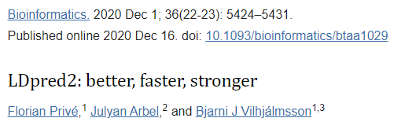
How do they perform? What one is the best?

Slide 13
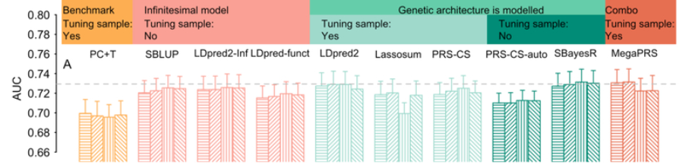
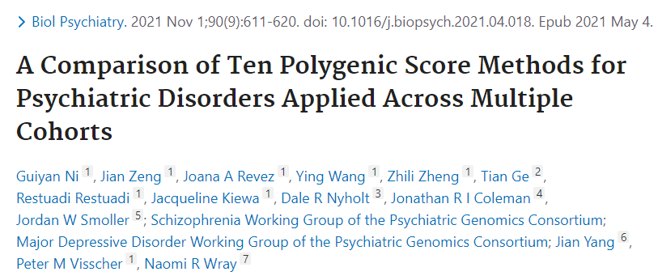
How do they perform? What one is the best?
Although the methods that more formally model genetic architecture have similar performance, MegaPRS, LDpred2, and SBayesR rank highest in most comparisons and are recommended in applications to psychiatric disorders.

Slide 14

So, I can’t tell you what is best, and better tools will be developed in a few years!

Slide 15
How much variation does PRS explain again?
We first need to discuss heritability

Slide 16
The many types of heritability
Broad-sense heritability (H²) is a measure that estimates the proportion of phenotypic variation in a population that is due to all genetic factors, including both additive and non-additive genetic effects. It includes the effects of additive genetic variation, dominance genetic variation and interactions between different loci.
Narrow-sense heritability (h²) is a measure that specifically estimates the proportion of phenotypic variation in a population that is due to the additive genetic effects of individual alleles or genetic variants.
SNP heritability (h²SNP) is a measure that specifically quantifies the proportion of phenotypic variation that can be explained by the additive effects of single nucleotide polymorphisms (SNPs), which are common genetic variants in a population. SNP heritability is estimated using genome-wide association study (GWAS) data

Slide 17
So does PRS capture what is in h²SNP?
NO!
Tell me what are some things it could be missing? (It does depend on the tool)
Some tools only use SNPs at a p-value cutoff
Most markers are lost, if you are joining with HapMap3
The X chromosome is often not included
Rare variation with strong effects Markers with low imputation INFO score
Gene by environment interactions
Others…?

Slide 18
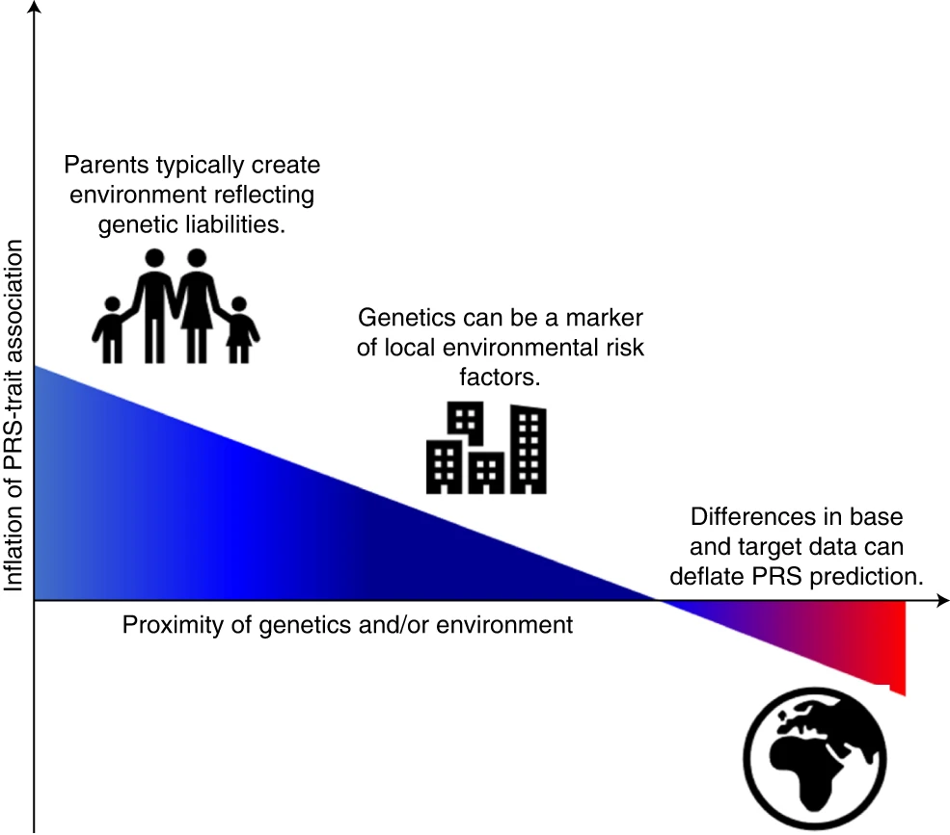
Major sources of inflation/deflation of PRS-trait associations
This inflation can be exacerbated by a household effect in which parents produce an environment reflecting their genetic tendencies, known as passive gene*environment correlation.
Correlation between the population structure of genetics and the environment can inflate PRS-trait associations unless they are controlled for fully.
If the target data differ markedly from the base data, then the PRS-trait association will probably be deflated relative to a target sample that is well matched to the base data.

Slide 19
PRS is not deterministic!
So you see that it only captures a fraction of the total genetic variation
Lots of important genetic information is not yet captured my most PRS tools
Other environmental factors can play a bigger role is disease risk

Slide 20
Now let’s discuss ancestries and PRS

Slide 21
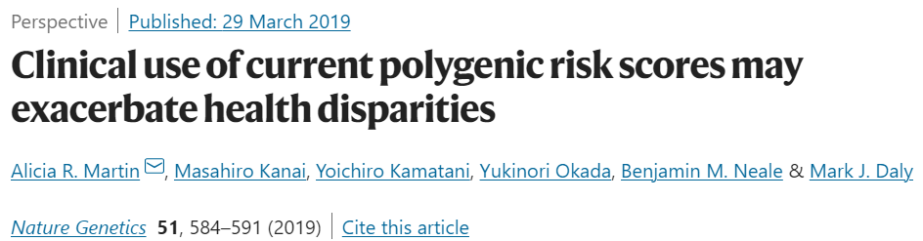
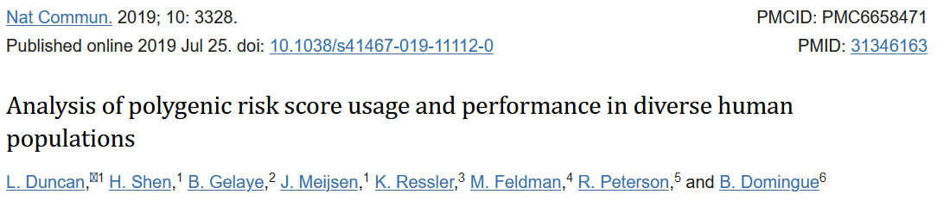
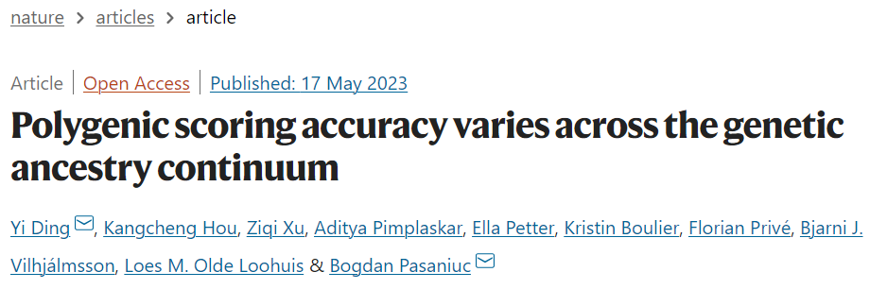

Slide 22
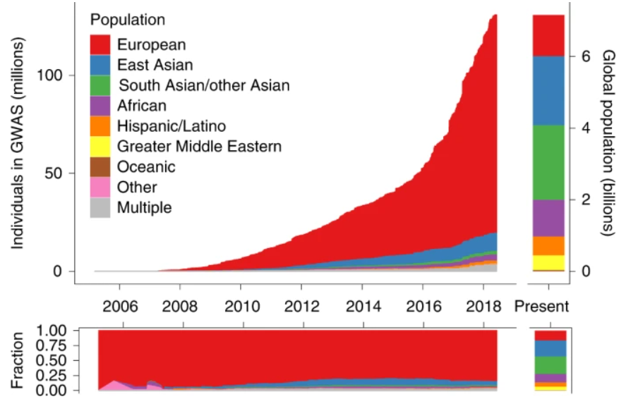

Ancestry of GWAS participants over time shows a bias

Slide 23
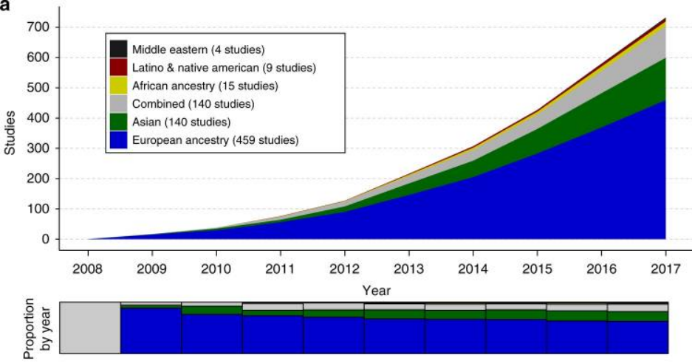
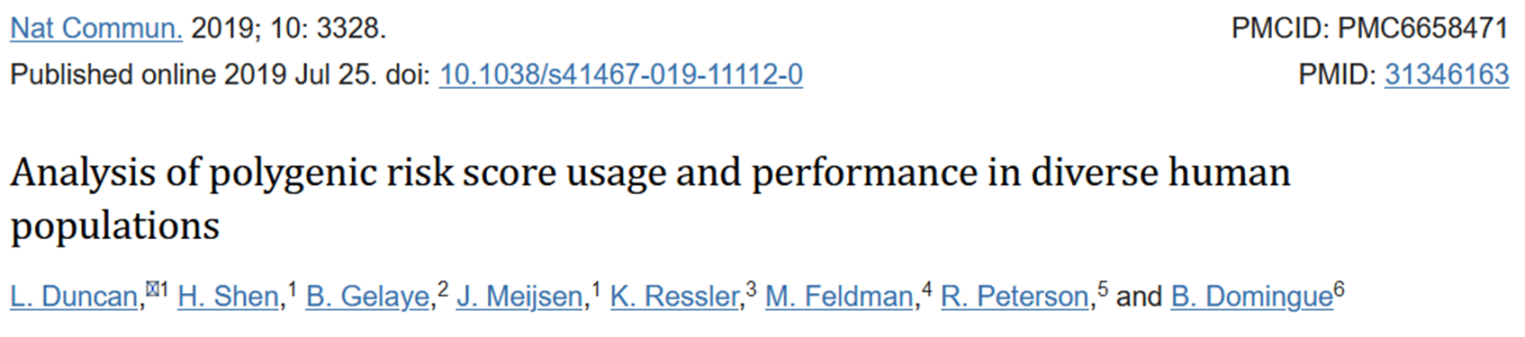
Ancestry representation in the first decade of polygenic scoring studies shows a bias

Slide 24
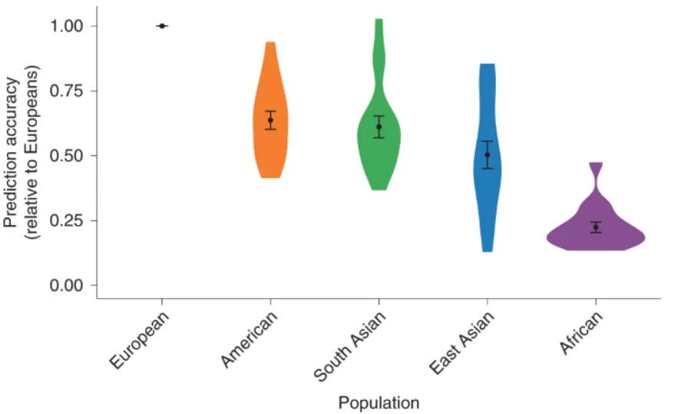
Prediction accuracy relative to European-ancestry individuals across 17 quantitative traits and 5 continental populations in the UKBB

Slide 25
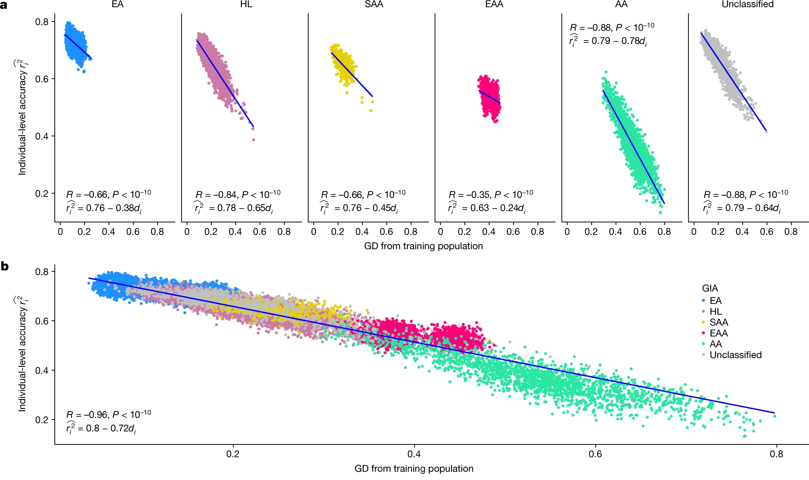
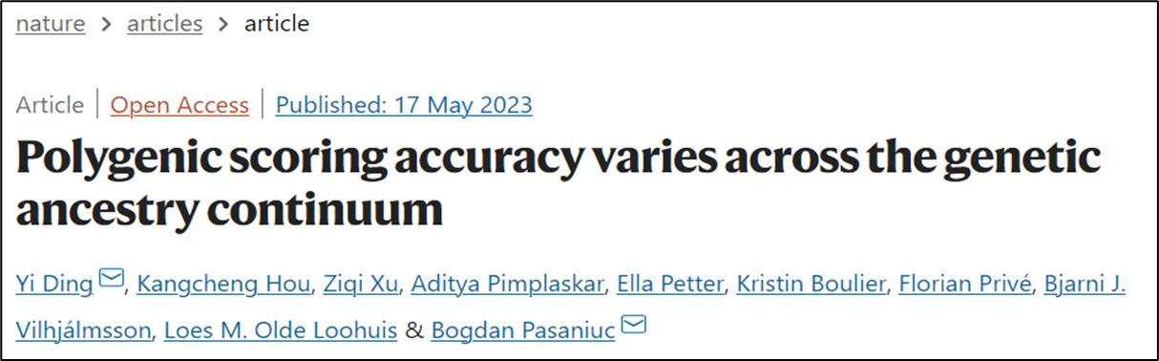
The individual-level accuracy for height PGS decreases across the genetic ancestry continuum in ATLAS

Slide 26

We will explore this together using your favorite disease/trait!

Slide 27
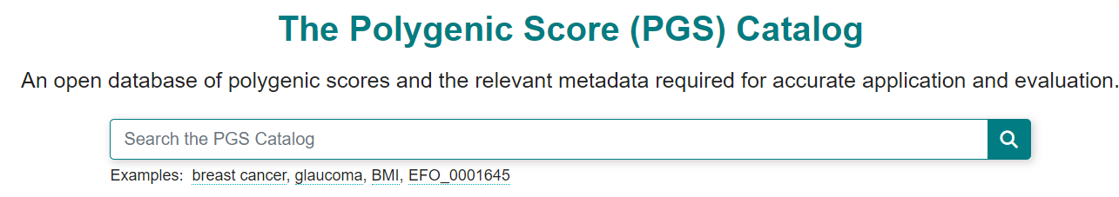
The Polygenic Score Catalog as an open database for reproducibility and systematic evaluation
https://www.pgscatalog.org

Slide 28
Background on this catalog
The challenges
There are major challenges with using PRS/PGS due to the lack of consensus on what is reported by researchers and how it is expressed.
The underreporting of key PGS information has led to problems comparing different scores that predict the same diseases, and testing which are the most accurate.

Slide 29
Background on this catalog
The solution
The PGS catalog is an open resource of published PGSs, that includes full scoring information annotated with the expertly curated metadata. It allows PGSs to be reused and evaluated so their accuracy and clinical value can be fully assessed.

Slide 30
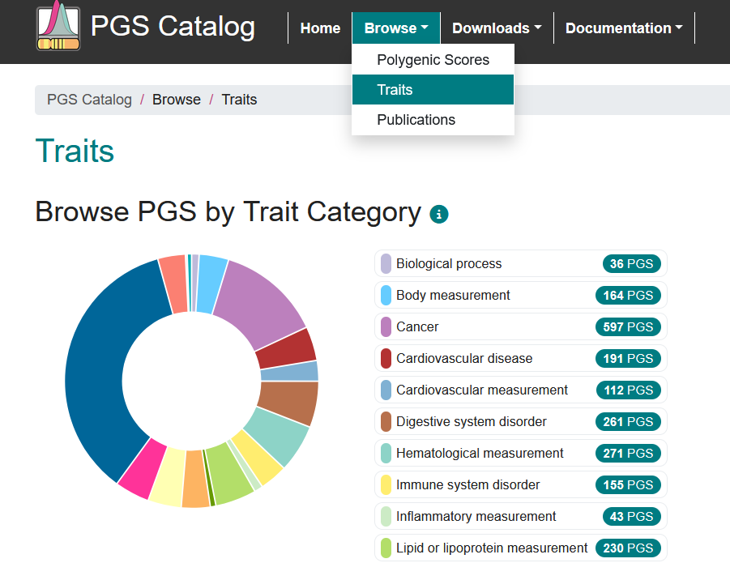
Let’s select a trait

Slide 31
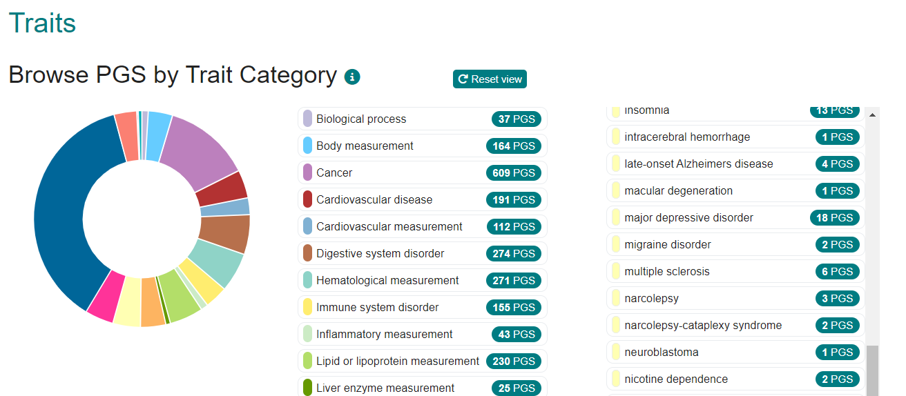
Several options to choose from

Slide 32
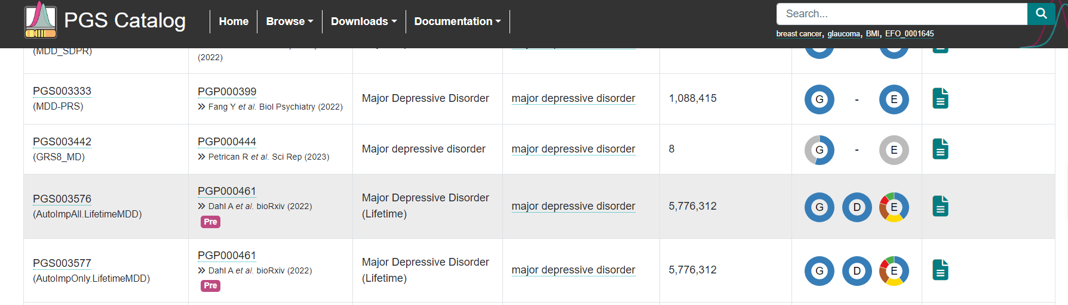
Let's pick this study

Slide 33
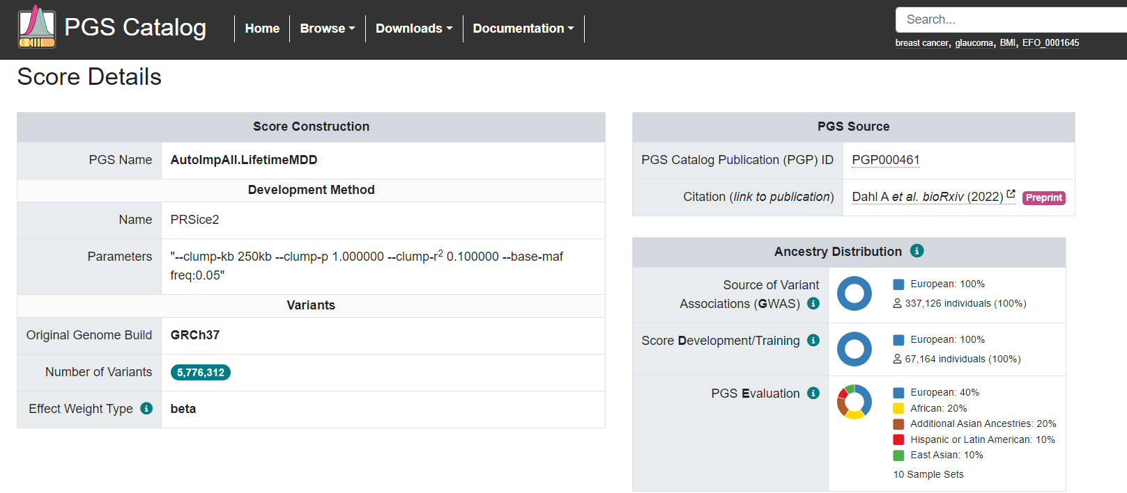
On this page you will find the number of significant variants, population ancestry, etc.

Slide 34
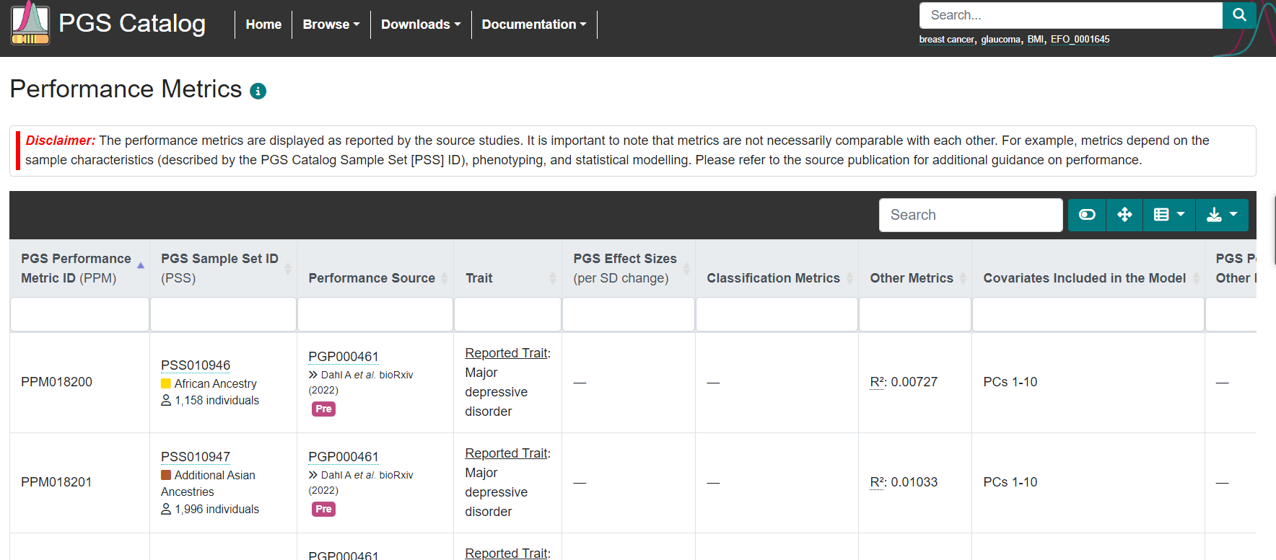
What are the performance metrics?

Slide 35

Now, tell me, why would some traits have OR/HR and others do not?

Slide 36
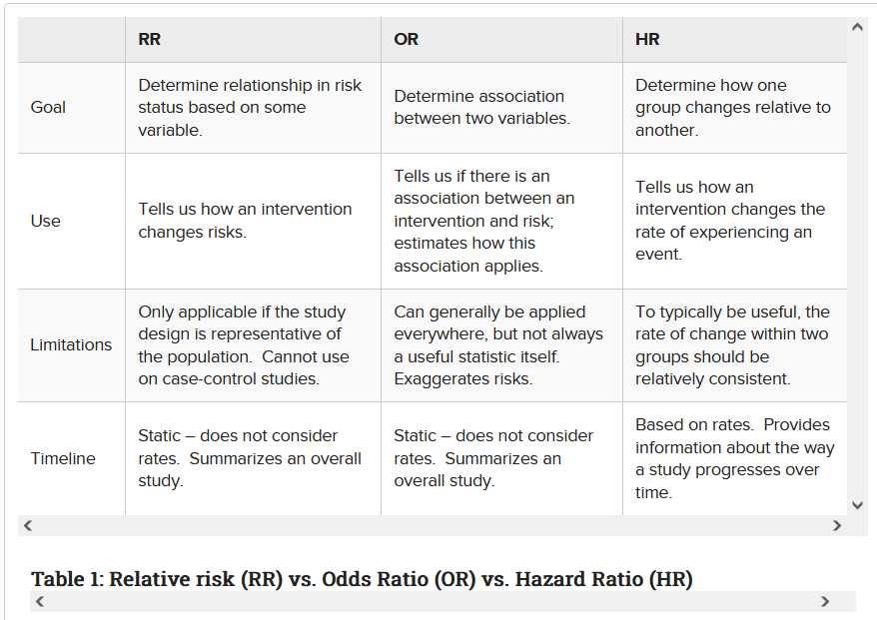
A little side note about Odds Ratio and Hazard Ratio

Slide 37
A little side note about other metrics
R-squared is a measure of the proportion of variance explained by the PRS in the phenotype of interest.
It quantifies how well the PRS predicts the phenotype and indicates the proportion of the phenotype's variability that can be attributed to genetic factors captured by the PRS. Higher R-squared values indicate a stronger relationship between PRS and phenotype.
Area Under the Receiver Operating Characteristic Curve (AUROC) is a metric commonly used in binary classification problems to evaluate the discriminative ability of a PRS model.
It represents the probability that a randomly selected case will have a higher PRS than a randomly selected control. AUROC ranges from 0.5 (no discrimination) to 1.0 (perfect discrimination). Higher AUROC values indicate better discriminative performance of the PRS model.

Slide 38
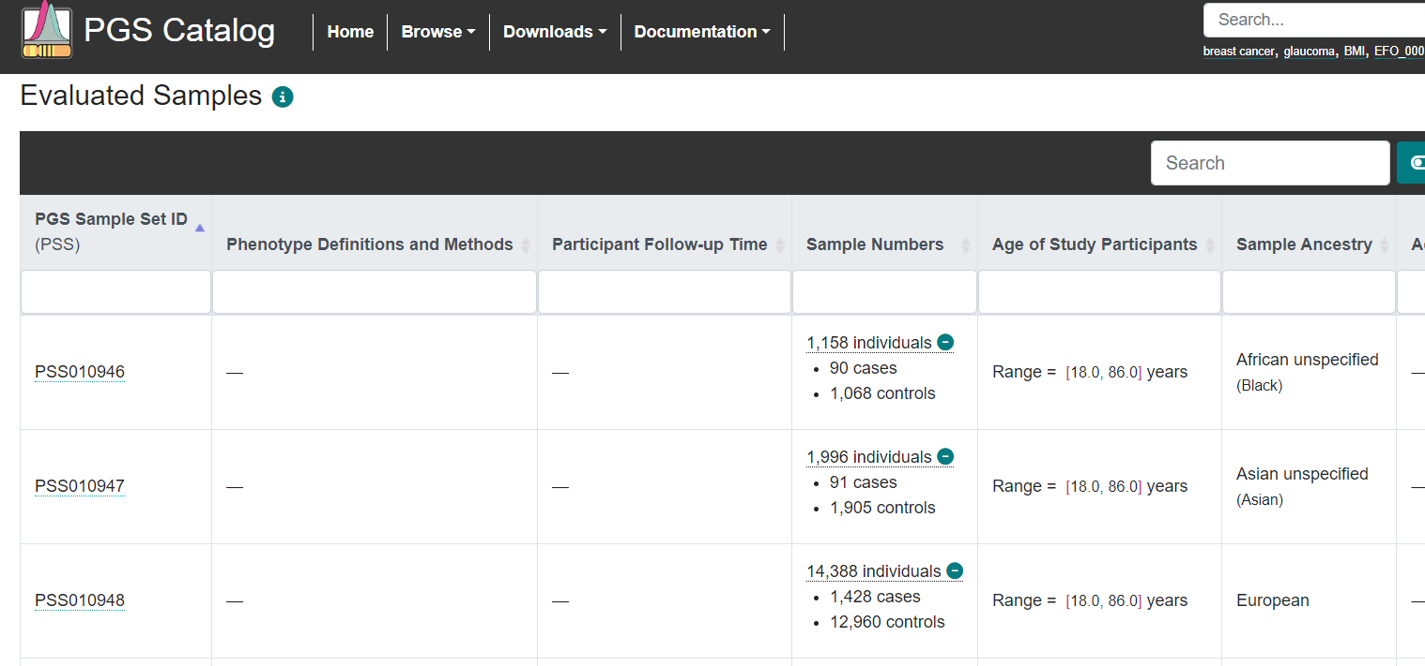
And information on the test samples

Slide 39
Your exercise today is to report how well PRS/PGS predicts your favorite disease/trait
As a group, we will fill out a google document about the performance of PGS/PRS on your favorite disease or trait (Maybe some should download and fill out the sheet locally, and add to the group sheet when finished)
Report the study name and ID, the sample size, number of variants, and ancestry distributions
What is the performance metrics? Are they done in the same or different ancestry populations? What are the reported PGS effect sizes or other metrics?
We will then discuss our finding together, and see how PRS performs across different ancestries

Slide 40
Using LDpred2 to create PRS

Slide 41
What to expect
I only have 1 hour to teach you how to use this tool!
We will therefore use this wonderful tutorial on LDpred2
https://privefl.github.io/bigsnpr/articles/LDpred2.html
This is written by Florian Privé
I have created an R markdown version of this, and we can go through each section and discuss key elements
You will need R and R studio to participate. (Or just watch and follow along)
You can always go back to this and watch his video tutorial

Slide 42
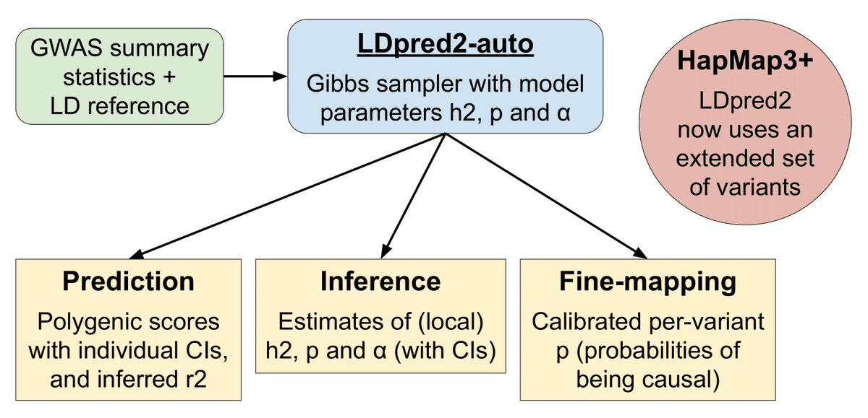
What can LDpred2 do?

Slide 43
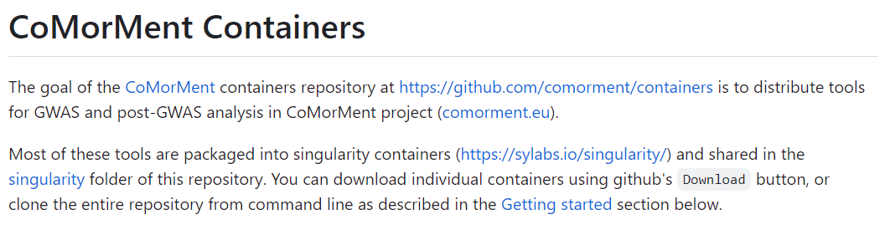
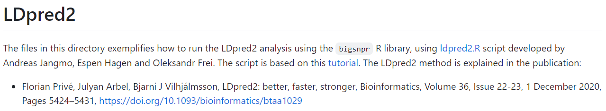
An important detail about using R for PRS
For a full data set, the memory usage is very heavy on your laptop
I am using the coMorMent containers for analysis, and run it on my HPC

Slide 44
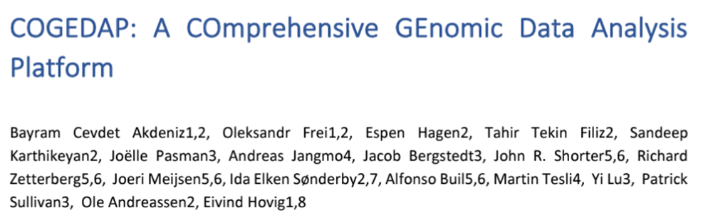

Slide 45
What you will need to do for this PRS workshop
Find my github: https://github.com/johnshorter/NSHG-PM2023
Download R and Rstudio (Maybe older versions work?)
If you are interested in the LDpred2 exercise, download the required packages

Slide 46

Any questions?

Slide 47
Bonus slides

Slide 48
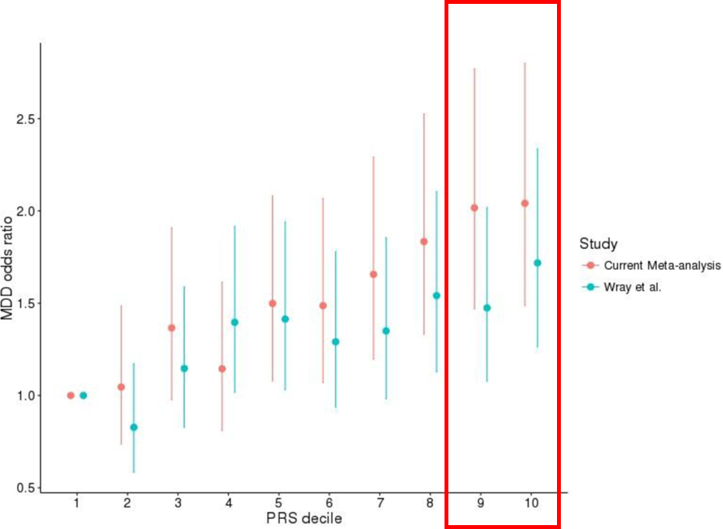
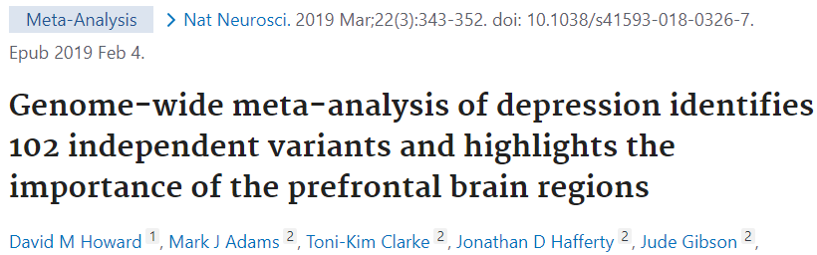
The clinical use of PRS is better at identifying those with the highest disease
But there are other challenges

Slide 49

Danish PRS guidelines
https://dsmg.dk/kliniske-guidelines/dsmg-guidelines/

